Slide 1
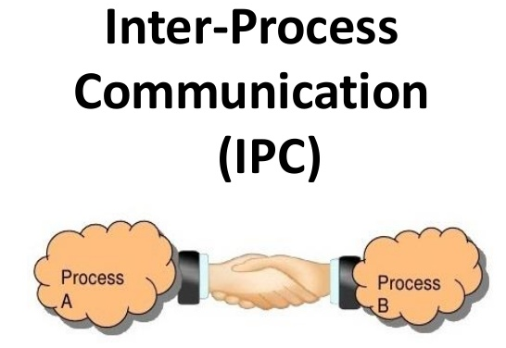
Sharing Memory
Message Passing

Slide 2
Transaction Look aside Buffer
Logical address
CPU
P
d
Physical address
Page number
Frame number (f)
0
0
1
Page
in
cache
Yes
0
0
TLB Hit
1
2
2
1
5
7
0
3
1
TLB
f
d
0
No
Yes
1
2
TLB Miss
0
3
1
4
5
6
7
Page table

Slide 3
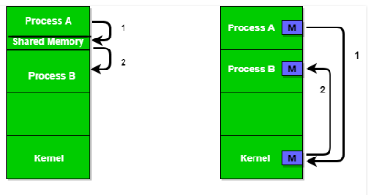
1. Sharing Memory

Slide 4
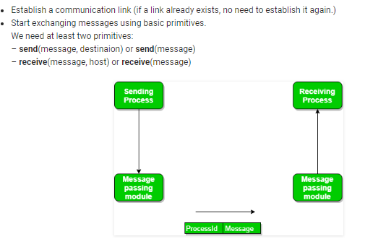
2. Message Passing

Slide 5

Threads
A thread (or lightweight process) is basic unit of CPU utilization; it consist of:
program counter register set stack space
A thread shares with its peer threads its (collectively know as a task):
code section data section OS resource
Traditional or heavyweight process is equal to a task with one thread
UFCFWK-15-2 (UWE)

Slide 6
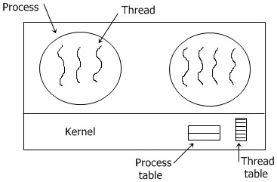

Slide 7
Threads (Cont.)
In a multiple threaded task, while one server thread is blocked and waiting, a second thread in the same task can run.
Cooperation of multiple threads in same job confers higher throughput and improved performance.
Applications that require sharing a common buffer benefit from thread utilisation.
stack space
Threads provide a mechanism that allows sequential processes to make blocking system calls while also achieving parallelism
Kernel-supported threads (Mac and OS/2)
User-level threads; supported above the kernel, via a set of library calls at the user level
Hybrid approach implements both user-level and kernel-supported threads (Solaris 2).
UFCFWK-15-2 (UWE)

Slide 8
What are threads?
Thread
A sequential execution stream within a process (also called lightweight processes)
Threads in a process share the same address space
Thread concurrency
Easier to program I/O overlapping with threads than signals
Users often like to do several things at a time: Read multiple emails A server (e.g. file server) serves multiple requests
Multiple CPUs sharing the same memory

Slide 9
Why Threads
Threads provide a number of capabilities to a user program, including.
They allow parts of an application to block without the whole program being forced to stop, e.g. while waiting for input/output

Slide 10
Why Threads
Decomposing an application into multiple sequential threads, that run in quasi-parallel, the programming model becomes simpler.
On modern multiprocessor systems, they enable an application to expose parallelism, allowing a program to be scheduled for both performance and power.

Slide 11
Single Thread vs Multi-threads
Single Thread
Has single thread of control
It allows the process to perform only 1 task at a time
Multi Thread
Has many threads
Simultaneous execution of different task

Slide 12
Benefits
Take less time to create a new thread than a process.
Less time to terminate a thread a processes.
Less time to switch between two threads within the same process.
Hence threads within the same process share memory and files, they can communicate with each other without invoking the kernel.
Economy
Utilization of MP Architectures.

Slide 13
Benefits
User Threads
Thread management done by user-level threads library (creation, scheduling)
Drawback: if kernel is single thread, then user level thread performance a blocking system call will cause entire process to block.

Slide 14
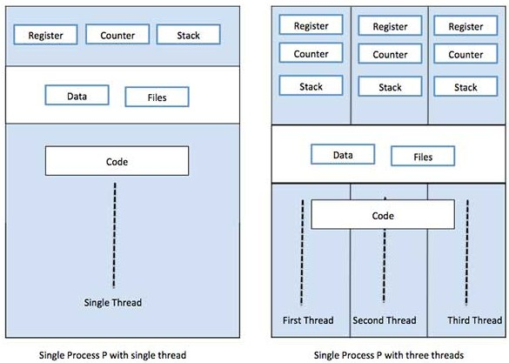
Single and multi threads

Slide 15
Thread Control Block (TCB)
State
Ready: ready to run Running: currently running
Blocked: waiting for resources
Registers (general purpose, PC, SP, etc) Status (FLAGS)
Stack Code
UFCFWK-15-2 (UWE)

Slide 16
Posix Thread API
Creation/Termination
create thread, pthread exit
Mutual exclusion
pthread mutex init, pthread mutex destory, pthread mutex lock, pthread mutex unlock
Many others
e.g., pthread yield
UFCFWK-15-2 (UWE)

Slide 17
Revisiting Process
Process
Thread Address space
Environment for the threads to run on OS (open files, etc.)

Slide 18
Thread Context Switch
Save a context (everything that a thread may damage)
All registers (general purpose and floating point) Need to save stack?
What about cache and TLB stuff?
Start a context
Does the reverse
May trigger a process context switch

Slide 19
Advantages of Threads
Threads minimize the context switching time.
Use of threads provides concurrency within a process. Efficient communication.
It is more economical to create and context switch threads.
Threads allow utilization of multiprocessor architectures to a greater scale and efficiency.

Slide 20
Types of Thread
Threads are implemented in following two ways
User Level Threads User managed threads.
Kernel Level Threads Operating System managed threads acting on kernel, an operating system core.
UFCFWK-15-2 (UWE)

Slide 21
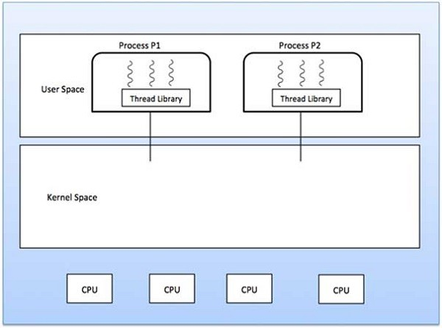
Single and multi threads

Slide 22
Threads vs Functions
Threads may resume out of order
Cannot use LIFO stack to save state
Each thread has its own stack
Threads switch less often
Do not partition registers
Each thread “has” its own CPU
UFCFWK-15-2 (UWE)

Slide 23
Threads vs Functions
Threads can be asynchronous
Function call can use compiler to save state synchronously Threads can run asynchronously
Multiple threads
Multiple threads can run on multiple CPUs in parallel Function calls are sequential
UFCFWK-15-2 (UWE)

Slide 24
Processes vs Threads
Address space
Processes do not usually share memory
Process context switch page table and other memory mechanisms
Threads in a process share the entire address space
Privileges
Processes have their own privileges (file accesses, e.g. ownership)
Threads in a process share all privileges
UFCFWK-15-2 (UWE)

Slide 25
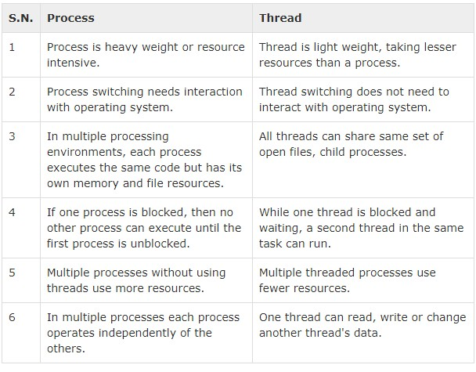
Differences between Process and Thread
UFCFWK-15-2 (UWE)

Slide 26
Summary
Concurrency
CPU and I/O Among applications
Within an application
Processes
Abstraction for applicaiton concurrency
Threads
Abstraction for concurrency within an application
UFCFWK-15-2 (UWE)

Slide 27
Thanks!
UFCFWK-15-2 (UWE)

